Slide 1

ONLINE CLASS
GRAPH THEORY
BICTE $6^{TH}$ SEMESTER
2078/02/18
PRESENTED BY KALYAN DAHAL

Slide 2
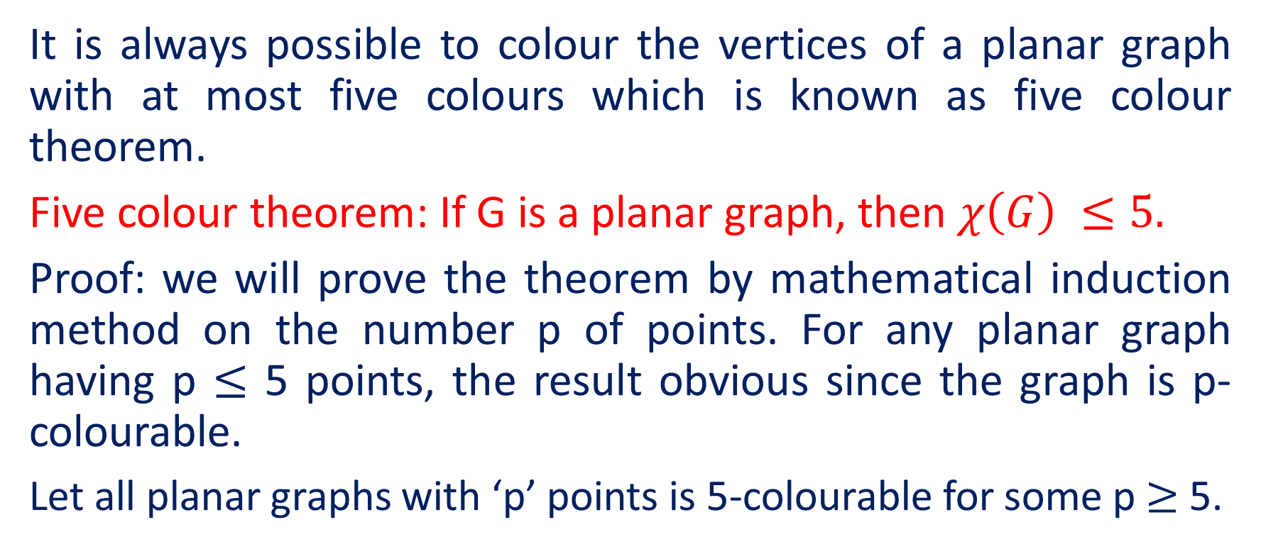
Five colour theorem
It is always possible to colour the vertices of a planar graph with at most five colours which is known as five colour theorem.
Five colour theorem: If G is a planar graph, then $χ\left(G\right) ≤5.$
Proof: we will prove the theorem by mathematical induction method on the number p of points. For any planar graph having p $≤$ 5 points, the result obvious since the graph is p-colourable.
Let all planar graphs with ‘p’ points is 5-colourable for some p $≥$ 5.

Slide 3
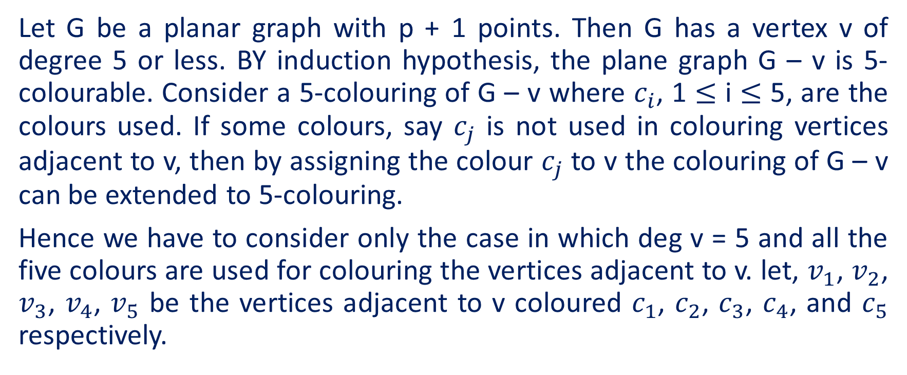
Continued….
Let G be a planar graph with p + 1 points. Then G has a vertex v of degree 5 or less. BY induction hypothesis, the plane graph G – v is 5-colourable. Consider a 5-colouring of G – v where $c_{i}$, 1 $≤$ i $≤$ 5, are the colours used. If some colours, say $c_{j}$ is not used in colouring vertices adjacent to v, then by assigning the colour $c_{j}$ to v the colouring of G – v can be extended to 5-colouring.
Hence we have to consider only the case in which deg v = 5 and all the five colours are used for colouring the vertices adjacent to v. let, $v_{1}$, $v_{2}$, $v_{3}$, $v_{4}$, $v_{5}$ be the vertices adjacent to v coloured $c_{1}$, $c_{2}$, $c_{3}$, $c_{4}$, and $c_{5}$ respectively.

Slide 4
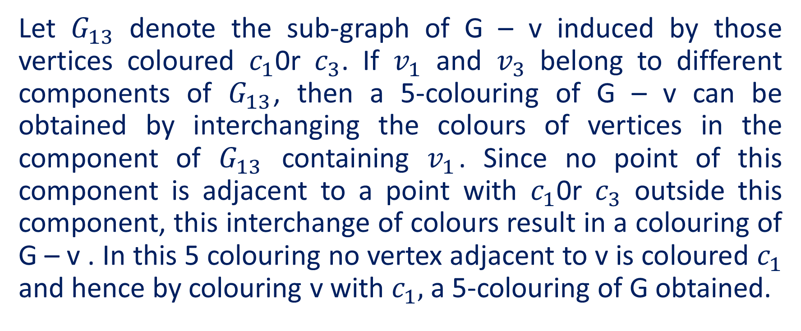
Continued….
Let $G_{13}$ denote the sub-graph of G – v induced by those vertices coloured $c_{1}$0r $c_{3}$. If $v_{1}$ and $v_{3}$ belong to different components of $G_{13}$, then a 5-colouring of G – v can be obtained by interchanging the colours of vertices in the component of $G_{13}$ containing $v_{1}$. Since no point of this component is adjacent to a point with $c_{1}$0r $c_{3}$ outside this component, this interchange of colours result in a colouring of G – v . In this 5 colouring no vertex adjacent to v is coloured $c_{1}$ and hence by colouring v with $c_{1},$ a 5-colouring of G obtained.

Slide 5

Continued….
$c_{3}$ $c_{1}$ $v_{1}$ $c_{3}$ $v_{2}$ $v_{5}$ $v_{4}$ v $v_{3}$ $c_{1}$ $c_{3}$ $c_{1}$

Slide 6
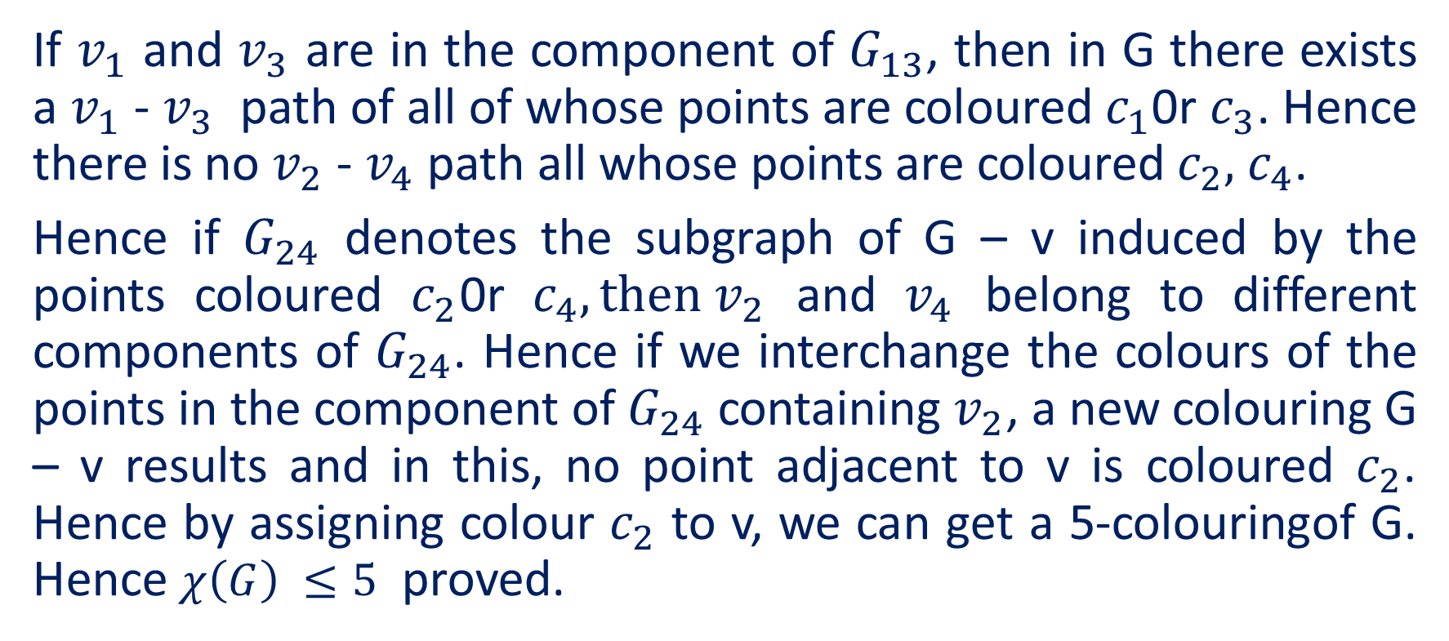
Continued….
If $v_{1}$ and $v_{3}$ are in the component of $G_{13}$, then in G there exists a $v_{1}$ - $v_{3}$ path of all of whose points are coloured $c_{1}$0r $c_{3}$. Hence there is no $v_{2}$ - $v_{4}$ path all whose points are coloured $c_{2},$ $c_{4}$.
Hence if $G_{24}$ denotes the subgraph of G – v induced by the points coloured $c_{2}$0r $c_{4}, then v_{2}$ and $v_{4}$ belong to different components of $G_{24}$. Hence if we interchange the colours of the points in the component of $G_{24}$ containing $v_{2}$, a new colouring G – v results and in this, no point adjacent to v is coloured $c_{2}$. Hence by assigning colour $c_{2}$ to v, we can get a 5-colouringof G. Hence $χ\left(G\right) ≤5$ proved.

Slide 7
Colouring map
Map:
Map is a connected planar graph without any bridge.
Adjacent region:
Any two regions of a map are called adjacent map if they have a common edge.
Colouring of map:
Colouring of map is an assignment of colours to the different regions of a map whose adjacent regions have different colours.

Slide 8
Continued ……
red blue green green red
Dual of map:
A new map developed from a given map is called dual of map.

Slide 9
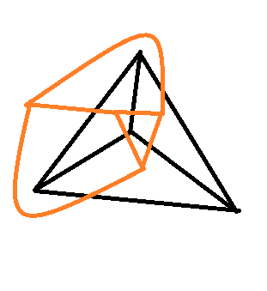


Continued…..
Here, $M^{|}$is a dual of the given map M.
$$M^{|}$$
M

Slide 10
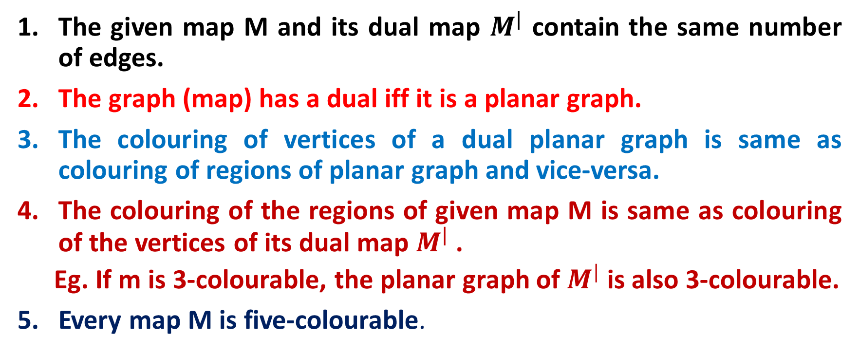
Note:
The given map M and its dual map $M^{|}$ contain the same number of edges.
The graph (map) has a dual iff it is a planar graph.
The colouring of vertices of a dual planar graph is same as colouring of regions of planar graph and vice-versa.
The colouring of the regions of given map M is same as colouring of the vertices of its dual map $M^{|}$ .
Eg. If m is 3-colourable, the planar graph of $M^{|}$ is also 3-colourable.
Every map M is five-colourable.

Slide 11
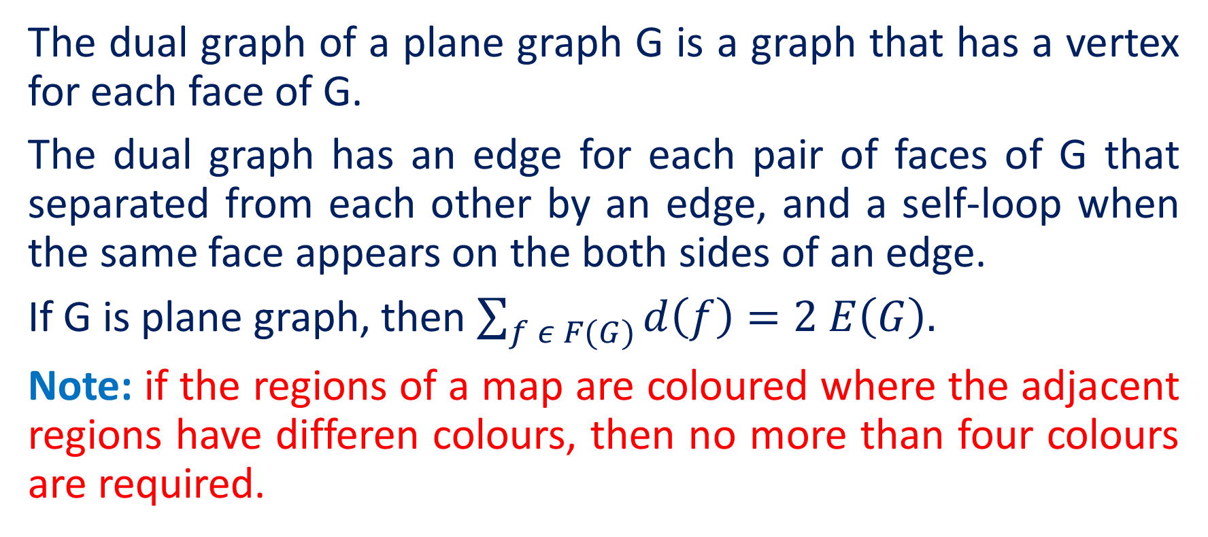
Dual graph:
The dual graph of a plane graph G is a graph that has a vertex for each face of G.
The dual graph has an edge for each pair of faces of G that separated from each other by an edge, and a self-loop when the same face appears on the both sides of an edge.
If G is plane graph, then $\sum_{f ε F(G)}{d\left(f\right)=2 E\left(G\right).}$
Note: if the regions of a map are coloured where the adjacent regions have differen colours, then no more than four colours are required.

Slide 12
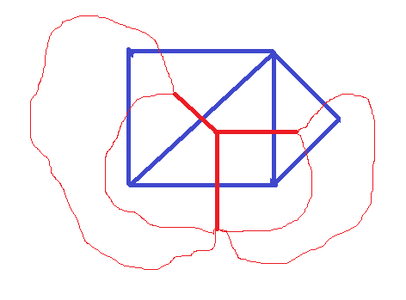

Figure of dual graph:
$$G^{|}$$
G

Slide 13
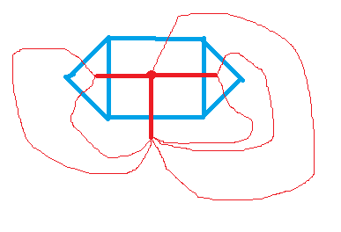

Figure of dual graph:
$$G^{|}$$
G

Slide 14


